Slide 1
Subreddit Classification
Group 1:
Huimin, Ramkumar, Rahayu, Shi Min, Eric

Slide 2
Context
Who are we?
Audience
We are a team of Data Analysts in a Tech Magazine Firm
Editor-in-chief and technology journalists

Slide 3
Agenda
01
04
02
05
03
06
Problem Statement
Exploratory Data Analysis
Data Scraping
Modelling & Interpretations
Data Filtering
Conclusion

Slide 4
01. Problem Statement

Slide 5




Problem Statement
Editor-in-chief wants to come up with a big year-end story on “Brand Dominance between Samsung and Apple”
TECH TALK
__________________
Brand Dominance between Samsung and Apple
Technology Journalists need a quick sense of the online chatters on Samsung and Apple
Data Analysts will develop a text classifier that is capable of distinguishing whether an online post is about Samsung or Apple and derive meaningful insights

Slide 6

How will a Successful Model look like?
Fairly Accurate
At least 80% accuracy and minimally better than baseline of about 50% accuracy in classifying a post
Little Overfitting
Difference between train and test accuracy is < 5%
Interpretable
Able to identify common features that distinguish each class of post

Slide 7
02. Data Scraping

Slide 8
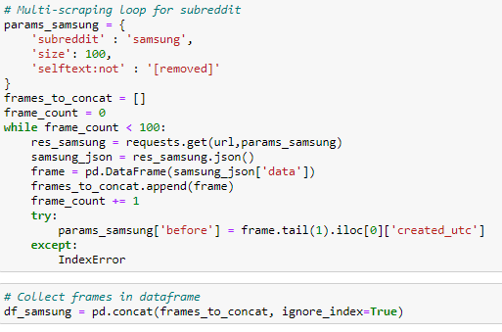

02. Data Scraping
Example of a function created for scraping data:
Data acquisition
Data was scraped from the two subreddits (r/Apple and r/Samsung) using Pushshift's API and selecting https://api.pushshift.io/reddit/search/submissions/ endpoint.

Slide 9
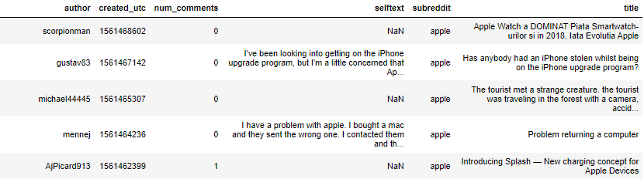
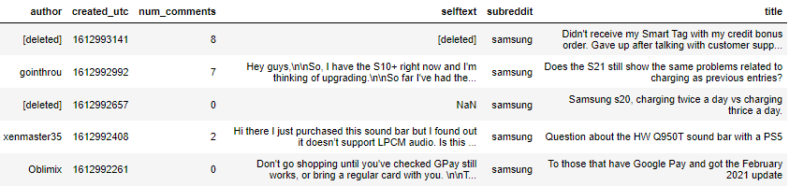
Examples of Data Scraped
From
r/Apple :
From r/Samsung :

Slide 10
03. Data Filtering

Slide 11
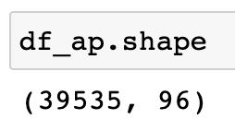
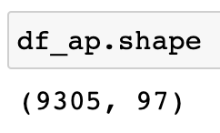
03. Data Filtering
Rows
Columns

Slide 12
Filtering the pulled data
Links
Newline characters
Removed
Regex was utilized to remove links
Removed
Found using python string methods
\n
Moderator posts
Removed
Author value counts/
Looking at authors’ flairs
Notes:
LINKS -
Using Regular expression filtering (Regex) to sift through data and find traces of links in the main body of text the same was done for
Moderator Posts - deemed not relevant to our use case. - We want to predict trends not announcements
The data allowed us to look at post author’s flair or status to quickly tell if they were a mod or not. Using just a line of code we are able to remove
Automoderator - weekly/daily discussion threads
Newline characters - would give us trouble when tokenizing
Built in python string methods help us quickly look through over 7 thousand posts and remove new line characters

Slide 13
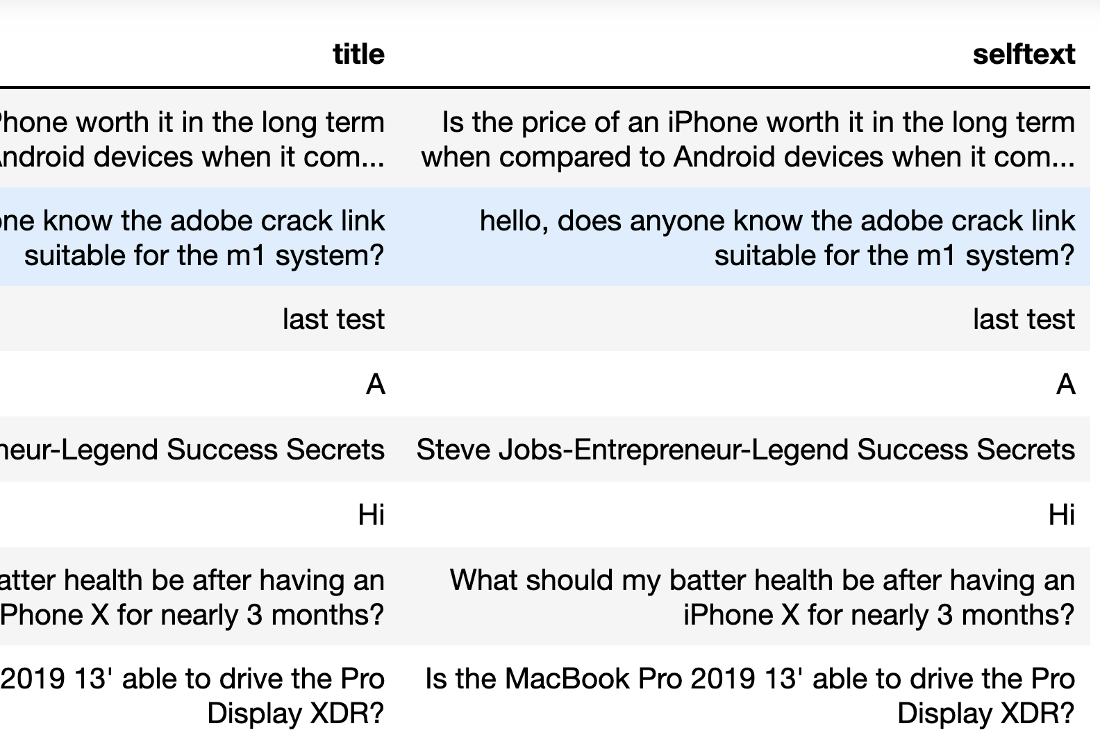
Filtering the pulled data
Null values in ‘selftext’
[‘deleted’] as ‘selftext’
Replaced
Singled out using boolean filtering/ built-in methods
Replaced
Conditional filtering
‘selftext’ = ‘title’
Replaced and later Removed
Notes:
Deleted as selftext - not removed for
Null Values -
Using boolean/built-in methods we are able to single out, and look at null values in selftext

Slide 14
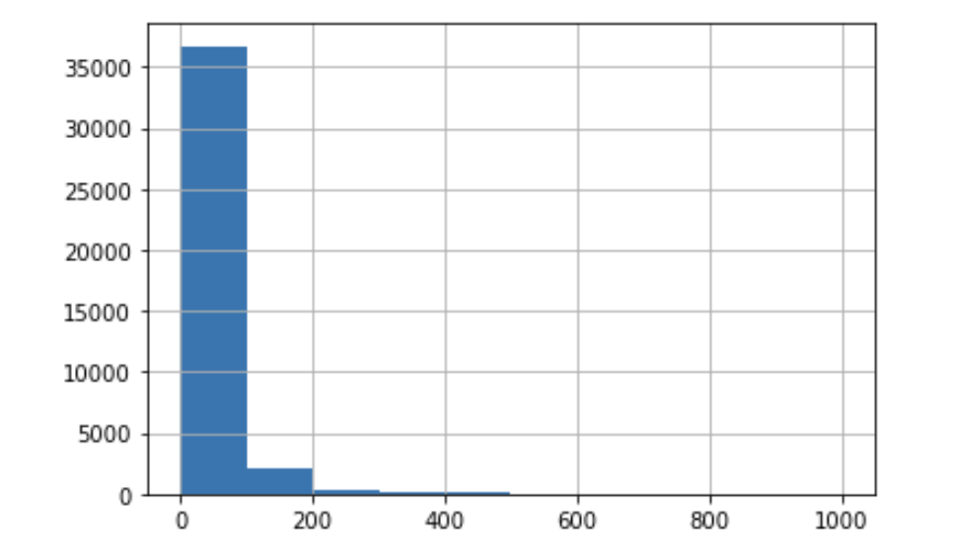
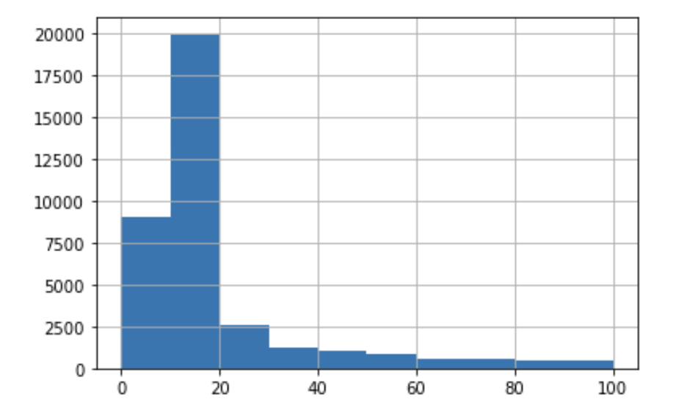
Filtering the pulled data
Number of Words per post in pulled data
(r/Apple)

Slide 15
Filtering and Feature engineering
Combined the title and selftext
Number of words in the combined text
Average sentence length in general is 15-20
Dropped rows with title + selftext having < 20 words

Slide 16
Cleaning the text
Tokenization - Splitting text into a list of words
Punctuation removal
Removing words with non-ASCII printable characters
Removing all empty strings
Lowercasing
Stopwords removal - Excluding words that occur frequently in all text
Lemmatization - Reducing all words to their base form

Slide 17
04. EDA

Slide 18
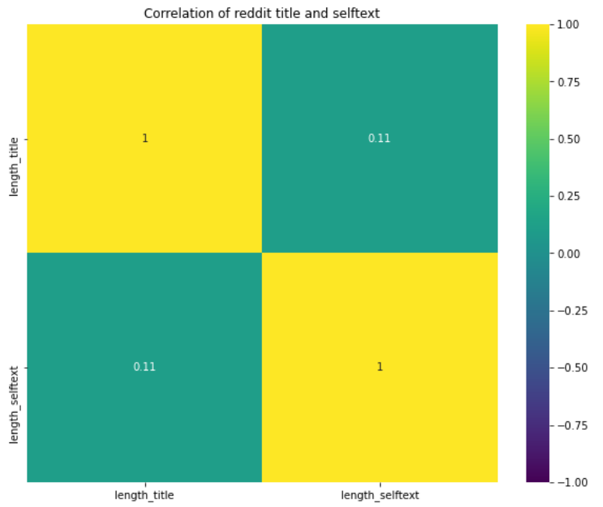
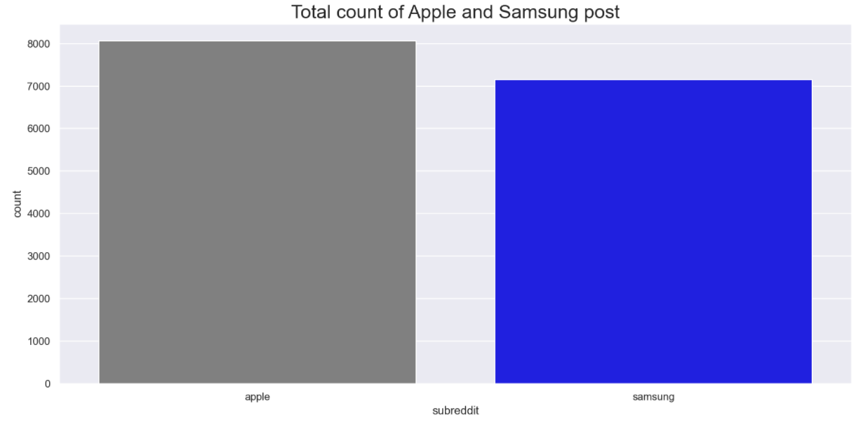
04. Exploratory Data Analysis
Apple have higher count than Samsung
Selftext and title length are not highly correlated
Notes:
After data filtering, we notice that apple have slightly more post count than samsung at 8065.

Slide 19
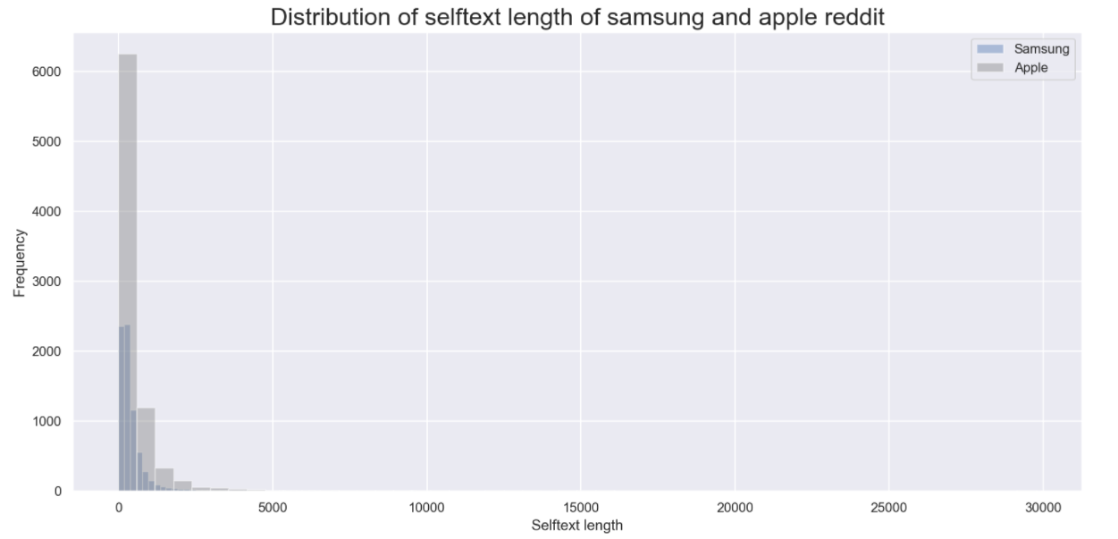
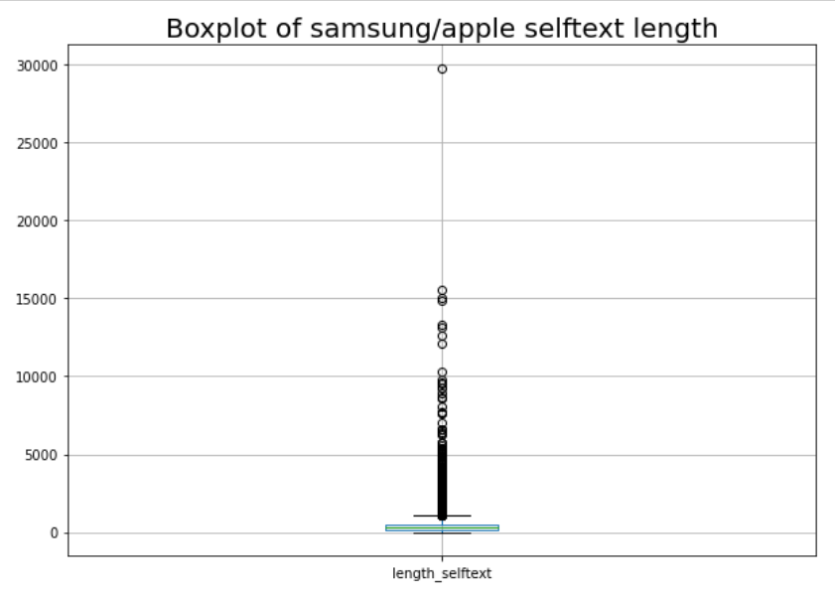
04. Exploratory Data Analysis
Distribution of self text length without filtering
Right-skewed for both
Range of characters between 20- 29,770
Median at 286 char
Notes:
Apple having the highest mode at 0-5 char comparing samsung at only 2.5k

Slide 20
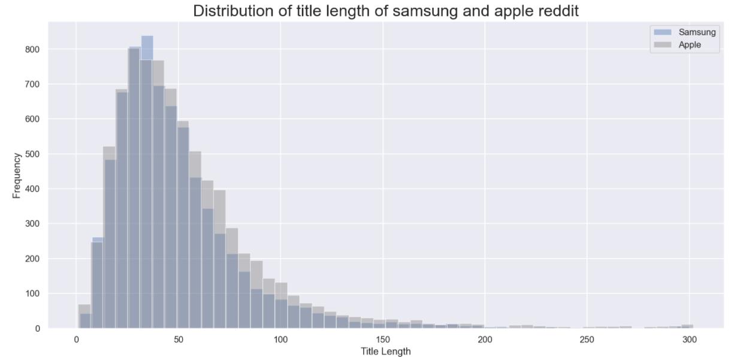
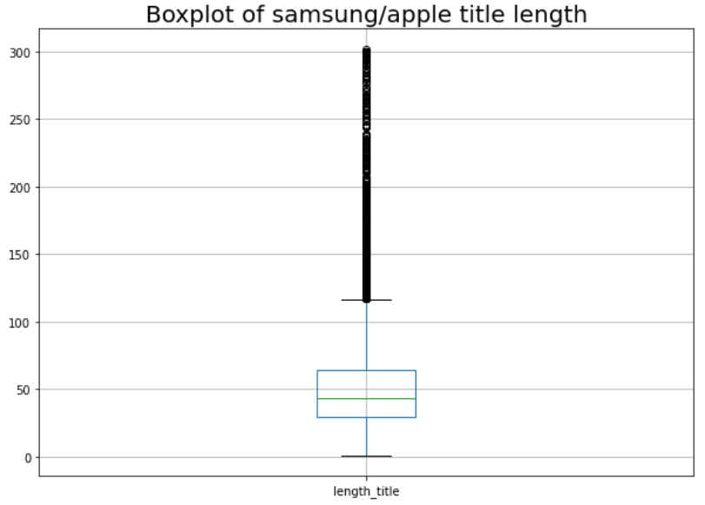
04. Exploratory Data Analysis
Distribution of title length
Right-skewed for both
Range of characters between 20 - 302
Median at 43 char

Slide 21
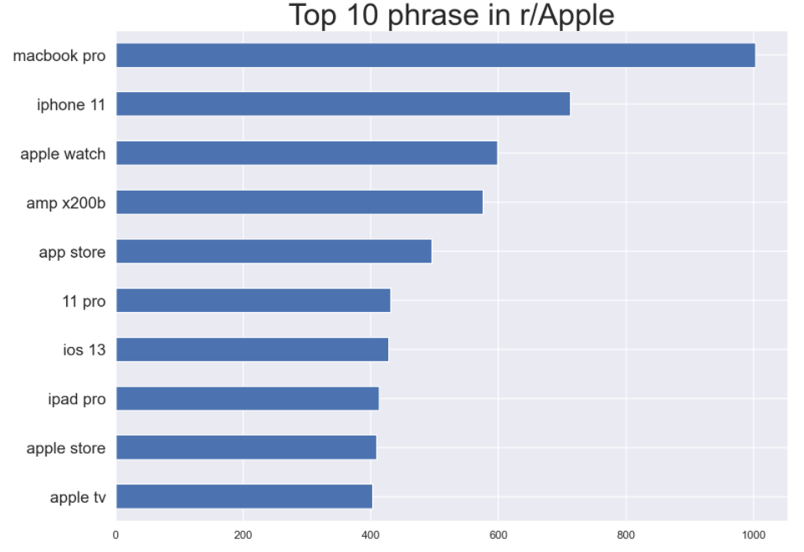
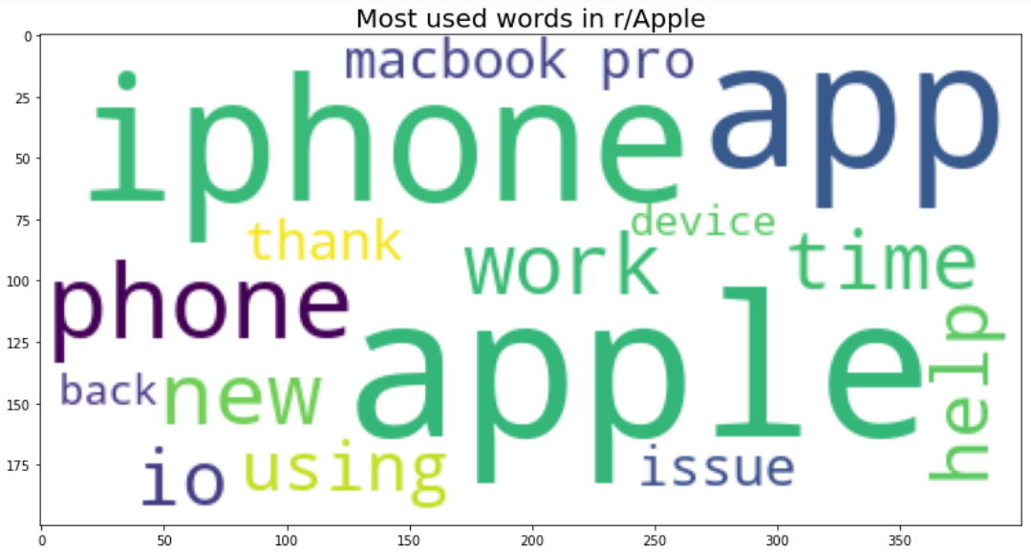
04. Exploratory Data Analysis
Most used words and phrases (without stopwords) in r/Apple
Notes:
We countvectorize the words to get the trend of words for both subreddit pre processing step.
In the left side, the most dominated words are iphone, apple and app with other key words.
In the right side, there is graph of most use bigram phrase in reddit apple as we can see are mostly their products especially products that are newly launched this year with macbook pro as the top.
vec = CountVectorizer(ngram_range=(2, 3), stop_words=stopwords)
Vectorize to 2,3 ngram range and remove stopwords and get only vocabulary items

Slide 22
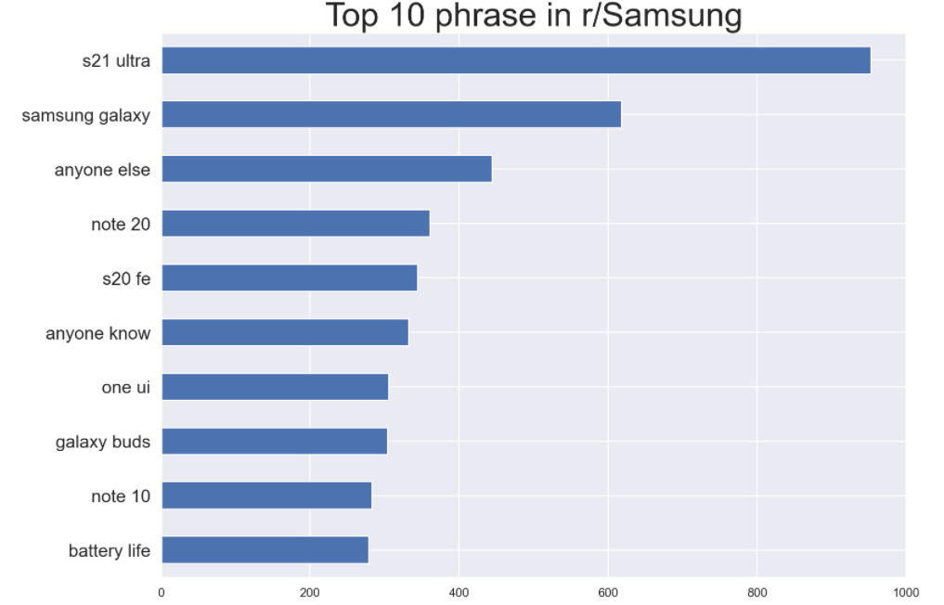
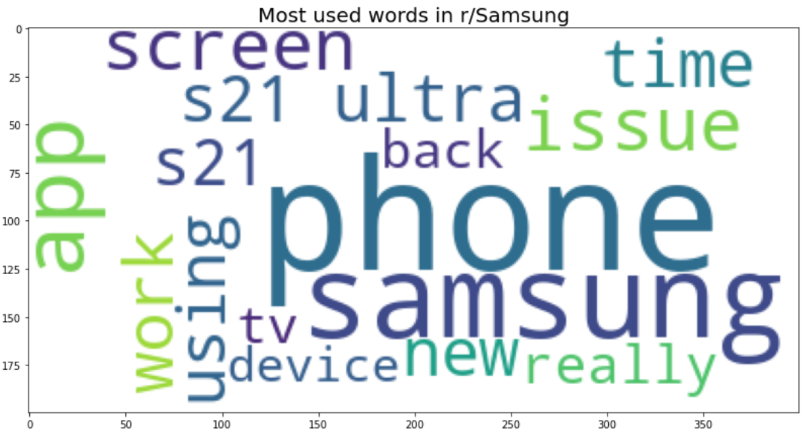
04. Exploratory Data Analysis
Most used words and phrases (without stopwords) in r/Samsung
Notes:
In the left side of the graph, Similar words such in apple like app and phone are found but of course the difference of instead the word apple, it is dominated by their brand name Samsung.
In the right side, as most use bigram phrase in reddit apple ,as we can see it is mostly dominated by their product name with s21 ultra at the top, which was release this year.

Slide 23
05. Modelling & Interpretations

Slide 24
Defining the Modelling Problem
Recap of the Problem:
Tech journalists need to assess the brand dominance of Samsung vs Apple
Need a quick way to sieve through numerous online word posts and classify them as Samsung or Apple, so as to assess which brand is more talked about
Bonus: To get insights on discussions that are specific to each brand, to know where the brand’s edge is
Binary Classification Problem
Able to identify keywords driving the classification model
Natural Language Processing needed
Notes:
Just to recap the problem statement once more: The tech journalists need to assess the brand dominance of Samsung vs Apple, and hope to do that by assessing whether there are more posts online that are discussing about Apple, or Samsung. This would mean that it is a binary classification problem, where the outcome is a classification of Apple, or Samsung
Given that these posts mainly consist of words, natural language processing will be needed. As a bonus, they also hope to get some insights on the discussion in the posts (other than simply classifying), hence it will be great if we can also identify the keywords driving the classification model

Slide 25

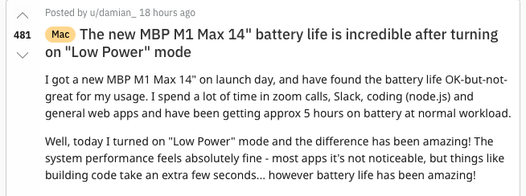
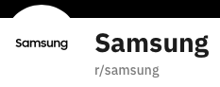
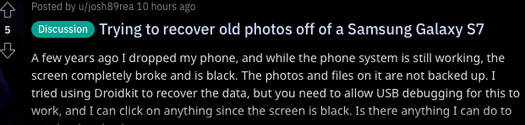
Modelling Pre-processing
Individual words from all posts
Tokenize, Remove Stopwords, Lemmatize, Vectorize
 | M1 | Galaxy | ... | Subreddit
Post 1 | 1 | 0 |  | Apple
Post 2 | 0 | 1 |  | Samsung
Frequency of M1 appearing in post 1
Notes:
I will quickly walk through the workflow of our modelling problem. Huimin and Ram have explained how we have scraped for the data from Reddit, filtered away irrelevant posts, and “cleaned” the texts by tokenizing, removing stopwords, lemmatizing. The final step is then to vectorize the words, which is simply to convert the words into a table of numbers, so that the data can be read by the model.

Slide 26
Model Train-Test
Individual words from all posts
Train the model
 | M1 | Galaxy | ... | Subreddit
Post 1 | 1 | 0 |  | Apple
Post 2 | 0 | 1 |  | Samsung
75% of posts
Apply on unseen posts and predict a classification
25%of posts
Frequency of M1 appearing in post 1
Prediction:
Prediction:
Notes:
After converting our wordy posts into something that the machine can read, we then split our dataset, with 75% used to train the model, and 25% being used as unseen data, to test how well the model can classify the unseen posts.

Slide 27
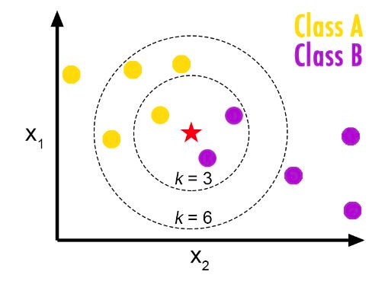
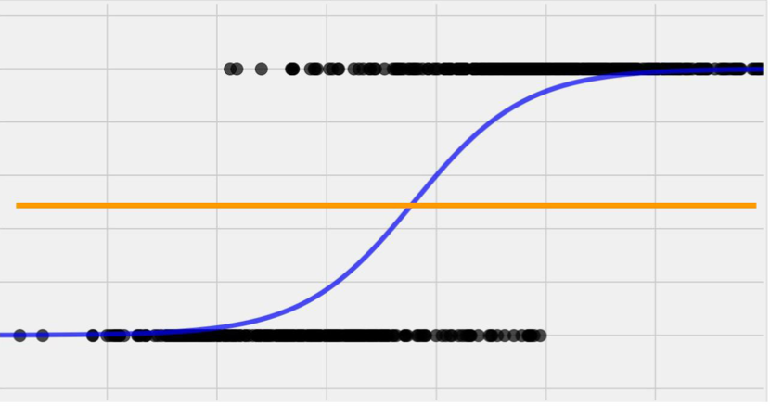
Shortlist of Model Choices
Multinomial Naive Bayes
Logistic Regression
K-nearest neighbors
Predicts odds of a post belonging to Apple, based on its relationship with the words that appear in the posts
Predicts classification of each new post, by observing how similar the words in the post are to the training observations, and labelling the post similarly to their “neighbors”
Calculates likelihood that a post belongs to Apple/Samsung, given the words in the post (conditional probability)
Apple
Samsung
New unknown post
Apple
Samsung
Notes:
These are the 3 models that we have shortlisted to try out on our dataset: Multinomial Naive Bayes, Logistic Regression, and K-nearest neighbors. A short introduction to each of these models: The multinomial Naive Bayes calculates the likelihood that a post belongs to Apple or Samsung, given the words present in the post, and the proportion of Apple and Samsung posts that contain those words. Logistic Regression estimates a relationship between odds of a post belonging to apple, with the words that appear in the posts. K-nearest neighbors predicts classification of each new post, by observing how similar the words in the new post are to the training posts, and label this new post similarly to their neighbors

Slide 28
Model Results
Test (Train) | Dummy Classifier | Multinomial Bayes | Logistic Regression | K-nearest neighbors
Accuracy | 0.50 (0.50) | 0.94 (0.96) | 0.95 (0.99) | 0.85 (0.86)
F1-score For Apple | 0.67 (0.67) | 0.94 (0.96) | 0.95 (0.99) | 0.83 (0.85)
F1-score For Samsung | 0.00 (0.00) | 0.94 (0.96) | 0.95 (0.99) | 0.87 (0.88)
Primary Metric
Notes:
These are the results of the 3 models, along with a comparison the a baseline model. The baseline model in this case is just to assume a very simplistic model. Given the training data, the model looks for the classification that is most prevalent in the training set, and blindly predicts that classification for every post, without even looking at the contents of the post. In our case, we have purposely maintained a class balance in our dataset, and hence there is no particularly dominant class, with apple taking 50.1% of the training posts and samsung 49.9%. Hence, you can see that the accuracy rate is about 50%, but F1 score for Samsung being 0 as none of the Samsung posts were correctly identified
We will be using accuracy as the main metric, as we place equal importance on both Apple and Samsung posts to be correctly identified. There is also no issue regarding class imbalance that may render this metric flawed. All 3 models have done far better than the baseline, with multinomial and logistic regression achieving around 95% accuracy on the test data. I have also included the F1-score for each of the classifications to ensure that the accuracy score does not mask problems with classification of any particular class
Additionally, we would also like to check for overfit, where the test score is way lower than train score. For all models, the difference has been quite small at <0.05, and hence we believe that the models can be implemented generically to unseen data and still achieve decent scores
Removed: Area under curve = 0.5(0.5), 0.99 (0.99), 0.99(1.00), 0.95(0.96)

Slide 29
The Chosen Model: Logistic Regression
Criteria | Multinomial Bayes | Logistic Regression | K-nearest neighbors
Accuracy
No Overfitting
Ease of Interpretability
Accuracy: >0.9: 3-stars, 0.8-0.9: 2-stars, 0.5-0.8: 1-star, <0.5: No stars
No Overfitting: Difference between train and test accuracy less than 0.05: 3 stars, 0.05-0.1: 2 stars, 0.1-0.2: 1 star, >0.2: 0-star
Ease of Interpretability is more subjective; takes into account how easy it is to explain how the model works, identify the key variables and how to interpret how important those variables are
Notes:
With the results above, I have mapped how well the model did in terms of stars for easy visualisation. In terms of accuracy, multinomial bayes and logistic regression did the best, and there was no overfitting issue as well. Given the close performance of both, I also considered the ease of interpretability, in this case, the logistic regression is able to tell us which of the words are key drivers of the model, and the coefficients can also be interpreted directly in terms of how it will increase the likelihood of a post belonging to Apple. I will pass the time to Eric to go through some findings that we had from the logistic regression model, as well as conclude our presentation

Slide 30
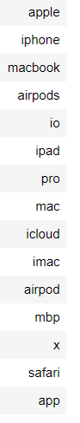
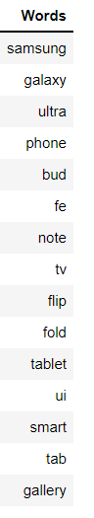
Key Predictors for Logistic Regression
Brand names and product names
May indicate which products are discussed most
Information for the upcoming magazine article?
Consistent with what we saw from the EDA section
What if we want to look beyond these words?

Slide 31
Words filtered out
'apple', 'iphone', 'iphones', 'macbook', 'ipad', 'pro', 'pros', 'airpods', 'airpod',
'ios', 'mac', 'catalina','itunes', 'imac', 'icloud', 'safari', 'macos', 'max', 'air',
'mbp', 'ipod','samsung', 'galaxy', 'ultra', 'note', 'bud', 'buds', 'fold', 'ui', 'tab',
'flip', 'z', 'fe', 'exynos', 'oneui', 'bixby', 'siri', 'mini', 'xr', 'smart', 'gallery',
'applecare', 'lightning', 'id', 'x', 'xs', 'se', 'pencil', 'airplay', 'pen', 'pens',
'earbuds', 'edge', 'gen', 'snapdragon', 'lite', 'phone', 'phones', 'tablet', 'tablets',
'tv', 'tvs', 'dex', 'thunderbolt'

Slide 32
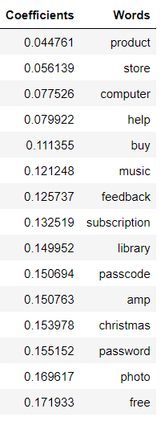
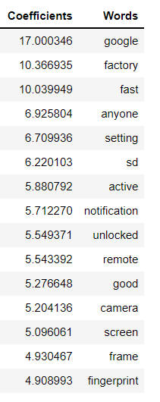
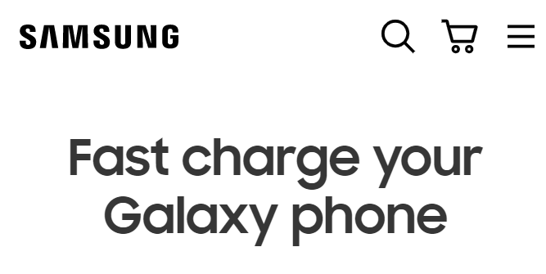
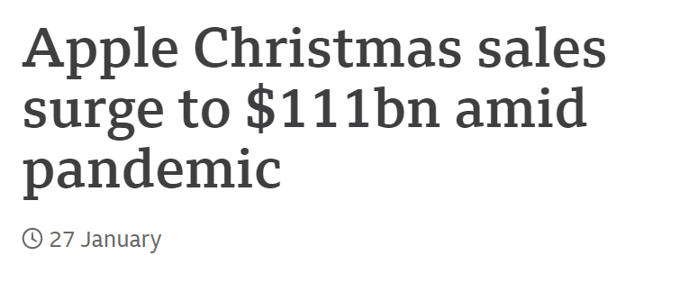

Predictors for Apple (product/
brand names excluded)
Predictors for Samsung (product/
brand names excluded)

Slide 33
06. Conclusion

Slide 34
A Successful Model
Metric | Logistic Regression
Accuracy On Test Set | 95%
Difference between Train and Test | 4%
Interpretability | Key predictive words can be identified
Fairly Accurate
At least 80% accuracy and minimally better than baseline of about 50% accuracy in classifying a post
Little Overfitting
Difference between train and test accuracy is < 5%
Interpretable
Able to identify common features that distinguish each class of post

Slide 35
Summary and Recommendations
The model is in a good position to be used as a tool by the Editor-in-chief
Conduct Share of Voice analysis more efficiently to measure brand dominance
Exploratory data analysis can reveal additional insights other than modelling
Sentiment analysis
Positive and negative words
Context of those words
Types of text classified
Social media
Product reviews

Slide 36
Thank you!

Slide 37
Appendix

Slide 38
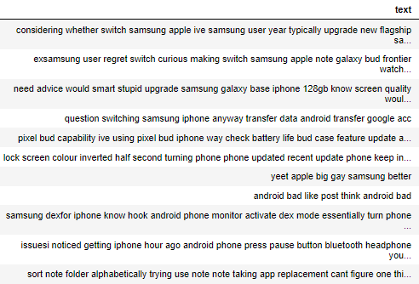
Apple posts classified as Samsung posts

Slide 39
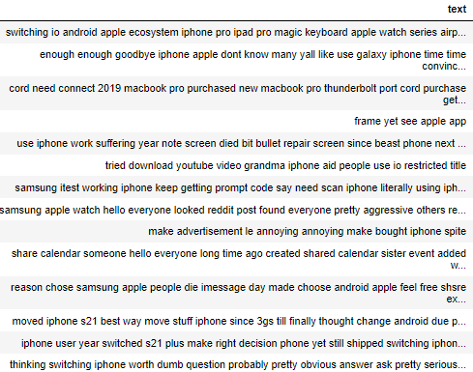
Samsung posts classified as Apple posts

Slide 40
Samsung post classified as Apple post
Apple post classified as Samsung post
iPhone 12 Pro Max to S21 Ultra worth the switch? Hello everyone, I've currently got an iPhone 12 Pro Max which I've had for about 10 months and have had issues with (battery life, software issues, etc) I can get an S21 Ultra on contract from my carrier for around £56 a month and was wondering if it's worth the switch this late into the year.
LPT: On safari if you open tab view and put your phone into landscape mode, you can long press on any tab and sort them by title or sort tabs by website. This is quite useful to sort tabs if you have around 200-300 open. Also a bonus tip, while in tab view, if you scroll all the way to the top and search for a certain tab and then long press the cancel button you can close all tabs matching your search result.

Slide 41
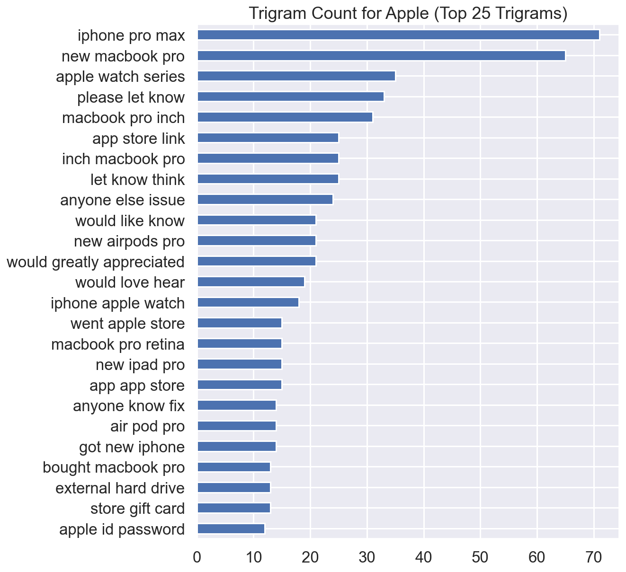

Slide 42
